Slide 1


Tornado Prediction: A Machine Learning Classification Approach
Project Proposal by Jessica Warner

Slide 2
Project Statement
Develop an Advanced Machine Learning Model for Accurate Tornado Prediction
Create a high-performance classification system that predicts tornado occurrences by analyzing complex weather patterns found in historical weather data, enhancing public safety through potential improved early warning capabilities.

Slide 3



Related Work
American Meteorological Society, titled “Machine Learning Classification of Significant Tornadoes and Hail in the United States Using ERA5 Proximity Soundings”. This journal assesses a method to identify and predict an often-unpredictable weather phenomenon by analysis of meteorological data such as wind and hail. (https://journals.ametsoc.org/view/journals/wefo/36/6/WAF-D-21-0056.1.xml )

Slide 4
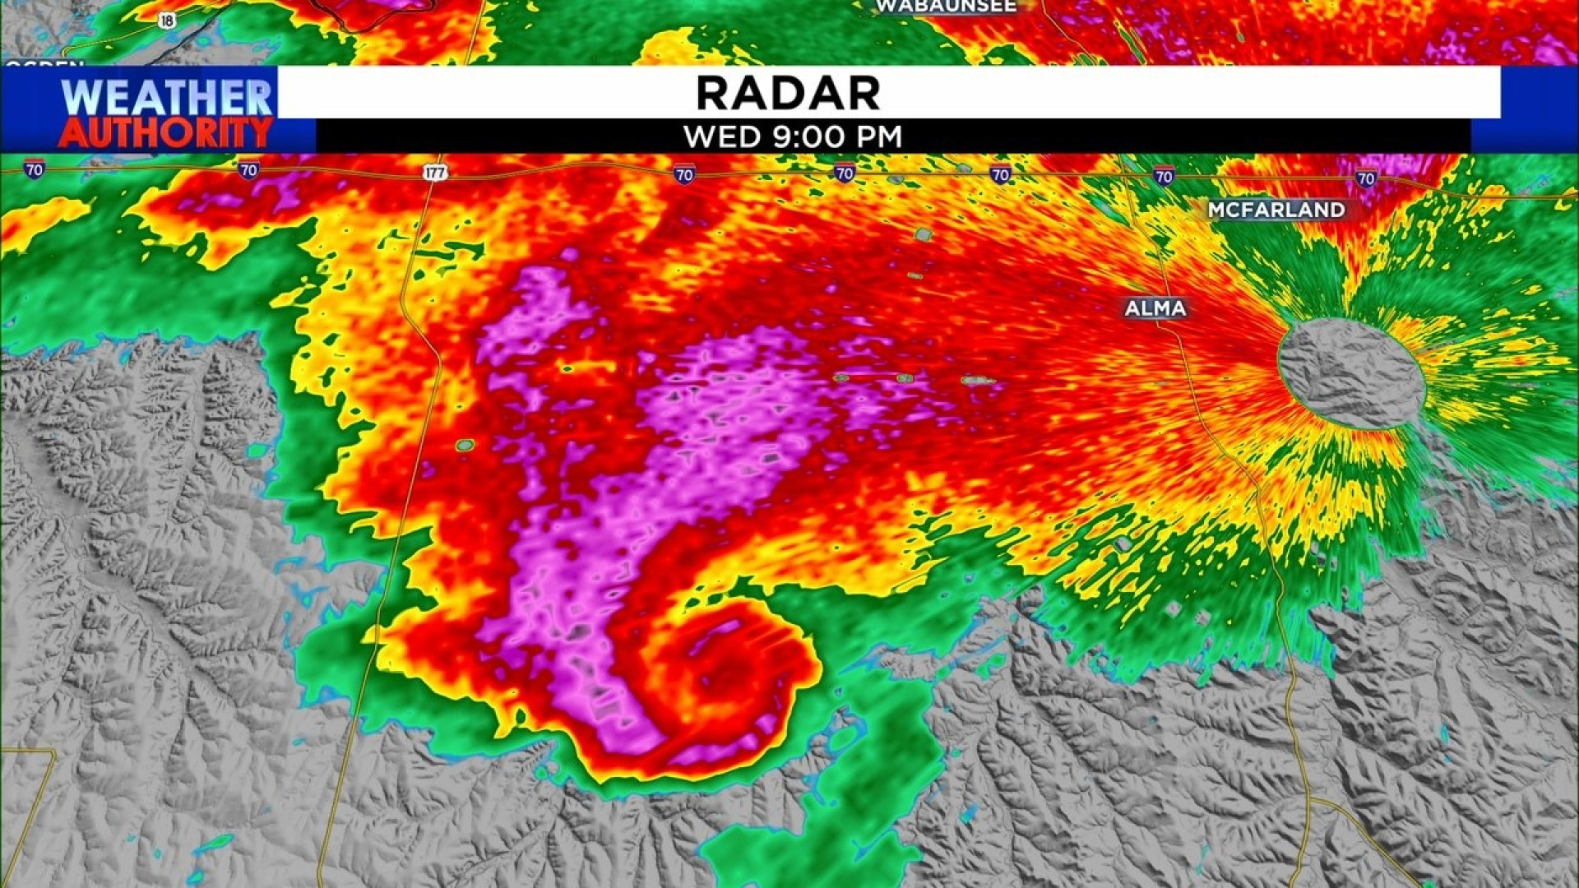
Proposed Work
1. Incorporation of region-specific weather and occurrence distribution for geographical and seasonal variations in tornado formation conditions.
2. Feature selection and engineering to assist with dimensionality reduction and identifying key variables
3. Potential integration of time-series analysis to capture the evolution of weather patterns leading up to tornado events.

Slide 5
Evaluation
Achieve High recall without significantly sacrificing precision
Most important metric because of consequences related to mislabeling non tornado occurrences.
ROC-AUC, Precision-Recall curves and F1 score in confusion matrix
Cross validation and grid search for hyperparameter tuning
Actual
True Positive
False Positive
Predicted
False Negative
True Negative

Slide 6
Timeline
Data Processing
EDA/Visualization
Model Tuning/Optimizing
Model Building
Feature Engineering
1-2 Days
1 Day
3+ Days
1 Day
2+ Days
Current status: identified dataset for tornado information and API for requesting historical weather data both for tornado data and non tornado data.

